Slide 1
Install COM Inbox Driver On Win8

Slide 2
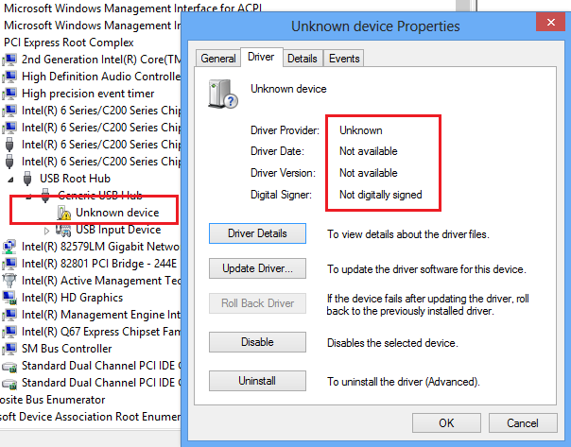
Install Step
Step 1: Plug in device
After device plugged into PC, an Unknown device with yellow mark will show in Device Manager
Double click this Unknown device, then click “Update Driver…”

Slide 3
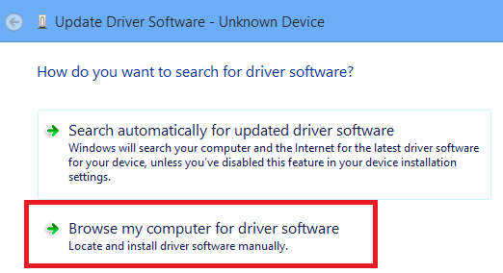
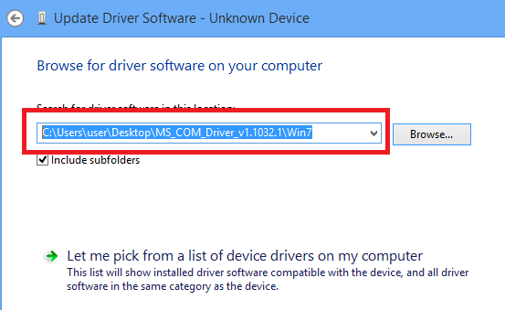
Install Step
Step 2: Appoint the driver install path
Click “Browse my computer for driver software””
Appoint the driver install path to “..\MS_COM_Driver_v1.1032.1\Win7”
Then click “Next”

Slide 4
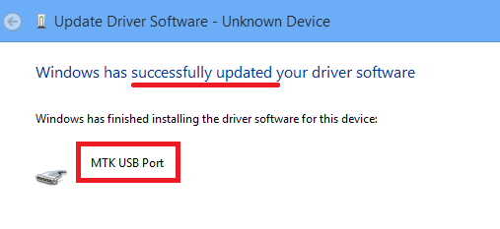
Install Step
Step 3: Driver install successfully
After a few seconds, driver will be installed successfully.

